Slide 1


GRAPH THEORY
Mosiur Rahman Sweet
Lecturer (Former) Department of Computer Science and Engineering
Varendra University

Slide 2
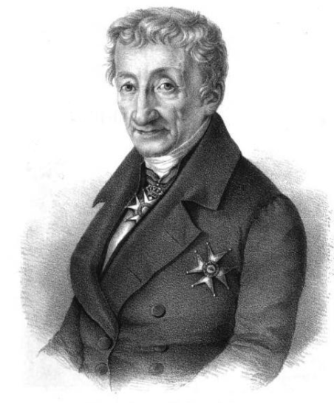

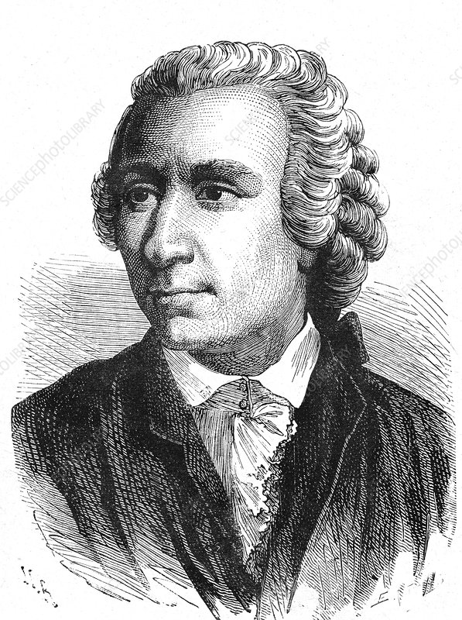
D
C
A
B

Slide 3
Bridge Of Konigsberg
DEGREE OF A : 5
DEGREE OF B: 3
DEGREE OF C: 3
DEGREE OF D: 3
D
A
C
B

Slide 4
Euler Path and Circuit
A graph has an Euler path if and only if there are at most two vertices with odd degree.
A
B
C
A graph has an Euler circuit if and only if the degree of every vertex is even.
A
B
C

Slide 5
The Geometry of Position
The Geometry of Position aka Graph Theory is the study of graphs, which are mathematical structures used to model pairwise relations between objects.
A graph is a collection of vertices (also called nodes or points) which are connected by edges (also called links or lines) to represent complex problems in a simpler manner.

Slide 6
Adjacent Node
Any two nodes connected by an edge or any two edges connected by a node are said to be adjacent.
A
B
C
In this graph, A & C both are the adjacent node of B.
B is the adjacent node of A
Also, B is the adjacent node of C

Slide 7
Directed & Undirected Graph
Directed graph are the ones with unidirectional edges.
A
B
C
Undirected graph are the ones with bidirectional edges.
A
B
C

Slide 8
Weighted & Unweighted Graph
If the edges has a weight or cost it is called weighted graph.
A
5
B
8
C
If the edges has no weight or cost it is called unweighted graph.
A
B
C

Slide 9
Path
Path can be defined as the list of edges by which we can visit one node to another.
B
A
5
8
C
D
3
In this graph, To visit D from A. The path will be:
A -> B -> C -> D

Slide 10
Degree
It is the number of vertices adjacent to a vertex V. In directed graph, the number of head ends adjacent to a vertex is called the indegree of the vertex and the number of tail ends adjacent to a vertex is its outdegree
A
5
B
8
C
In undirected graph, indegree = outdegree
A
B
C

Slide 11
Tree
A tree is an undirected graph in which any two vertices are connected by exactly one path.
A
B
C
In Tree, for n-node there will be exactly (n-1) edges. We can also create a forest combining two or more trees.

Slide 12
Graph Representation
In code , we can represent graph with
Adjacency Matrix (2D Array)
Adjacency List (STL Vector/List)

Slide 13
Adjacency List
1
2
1
2
4
5
2
1
3
4
4
3
3
2
5
4
1
2
5
6
5
1
3
6

Slide 14
Adjacency Matrix
 | 1 | 2 | 3 | 4 | 5
1 | 1 | 1 | 0 | 1 | 1
2 | 1 | 0 | 1 | 1 | 0
3 | 0 | 1 | 0 | 0 | 1
4 | 1 | 1 | 0 | 0 | 0
5 | 1 | 0 | 1 | 0 | 0
1
2
4
3
5

Slide 15
Level
1
1
2
2
4
5
4
3
3
5

